Slide 1
Week 7 - Practical
Using Git Command Line

Slide 2
Outline
Install Git Command line
Create a new repository
Initialize a local repository on your machine
Check the status of your files.
Push files to the remote repository
Collaborate with another teammate
Deal with Conflicts
Notes:
2

Slide 3
Step 1: Install Git Command Line

Slide 4
Installation on Windows
Download Git from Git for Windows at http://msysgit.github.io/
Install it.
Notes:
4

Slide 5
Installation on Mac (1/2)
Install Homebrew
(ONLY IF YOU HAVE NOT INSTALLED IT ALREADY)
Copy & paste the following into the terminal window and hit Return
ruby -e "$(curl -fsSL https://raw.githubusercontent.com/Homebrew/install/master/install)"
brew doctor
You will be offered to install the Command Line Developer Tools from Apple.
Confirm by clicking Install. After the installation finished, continue installing Homebrew by hitting Return again.
Notes:
5

Slide 6
Installation on Mac (2/2)
Install Git
Copy & paste the following into the terminal window and hit Return
brew install git
You can use Git now.
Notes:
6

Slide 7
Installation on Linux
Debian-based Linux systems
Copy & paste the following into the terminal window and hit Return
Red Hat-based Linux systems
Copy & paste the following into the terminal window and hit Return
sudo apt-get update
sudo apt-get upgrade
sudo apt-get install git
sudo yum upgrade
sudo yum install git
Notes:
7

Slide 8
Check that your installation was successful (on MacOS/Linux only)
Type the following command on the console
It should print the git version that you have currently installed. For example, you should visualize a message similar to the following one:
git --version
git version 2.20.1 (Apple Git-117)
Notes:
8

Slide 9
Step 2: Create a New Repository

Slide 10
Create a Repository
Repository
The place where developers store all their work
Not only stores files but also the history of changes
Accessed over the network
To host a repository we will use GitHub which is a web-based hosting service for version control using Git.
Notes:
10

Slide 11
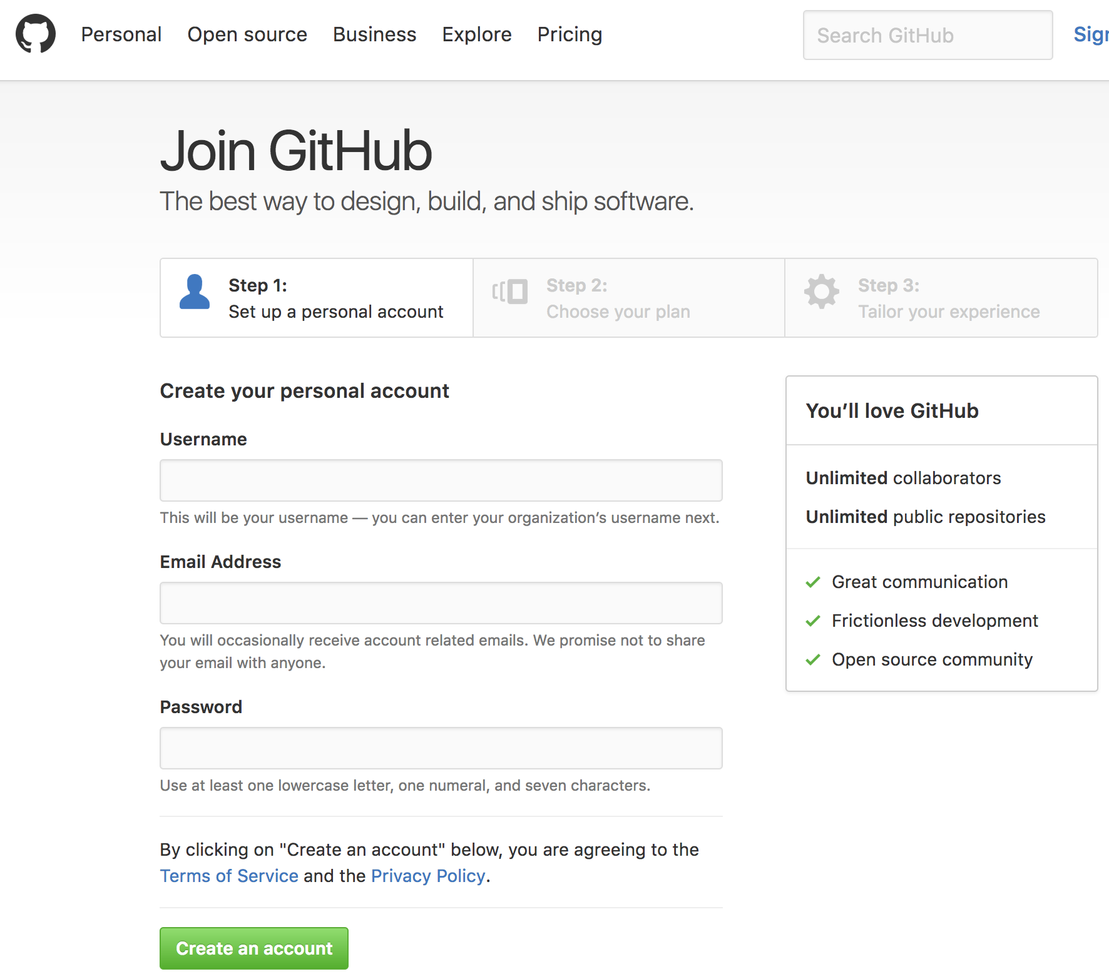
Create a GitHub account
Open your favourite browser and go to https://github.com/join?source=login
Fill the fields necessary to register and click on “Create an account”
Notes:
11

Slide 12
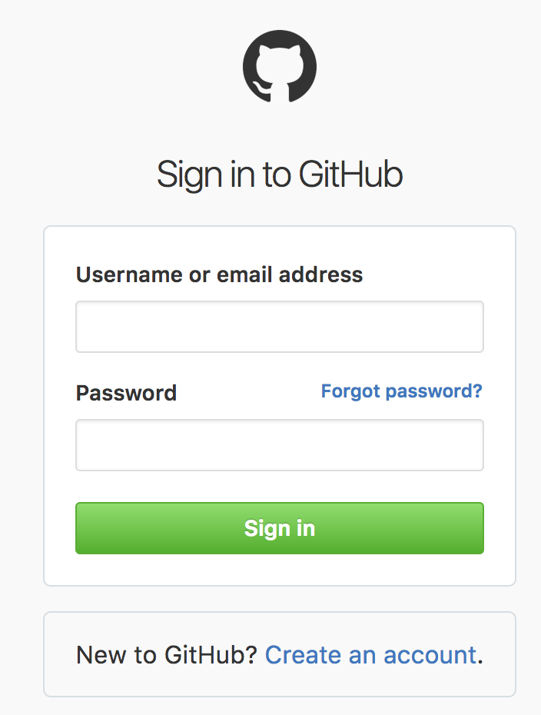
Login to Github
Go to https://github.com/login
Input the username and password you used to sign up on GitHub
Notes:
12

Slide 13
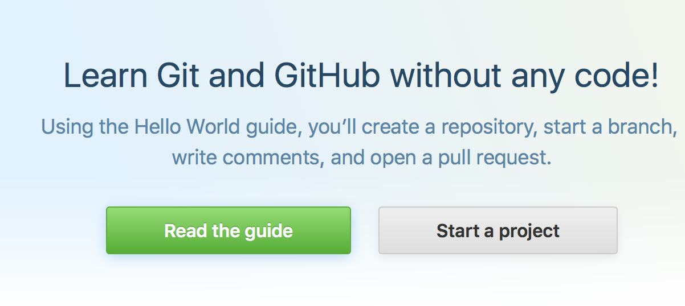
Create a New Repository
Click to “Start a Project”
Notes:
13

Slide 14
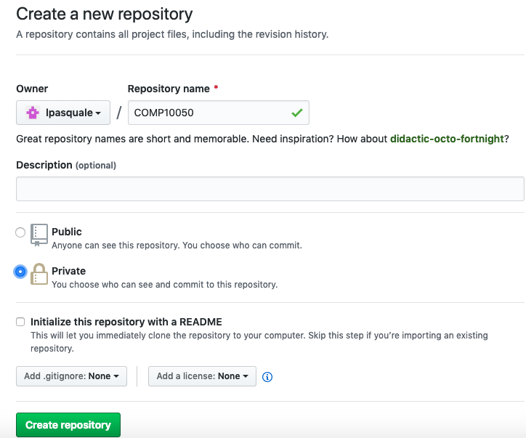
Create a New Repository
Insert a repository name (e.g., COMP10050).
Set the repository as private
Click “Create Repository”
Notes:
14

Slide 15
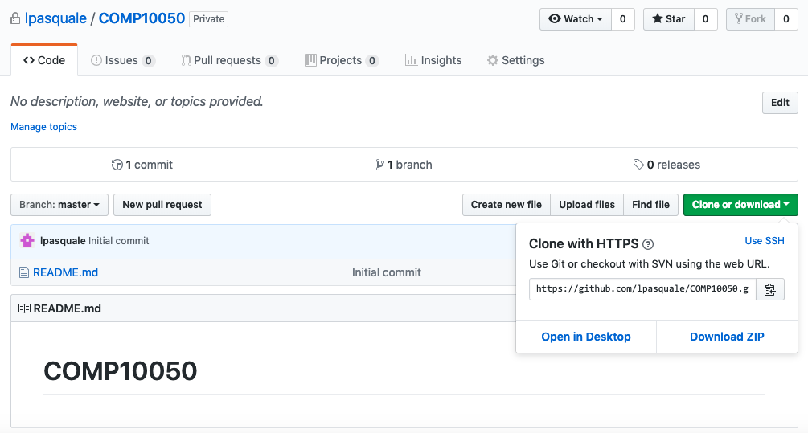
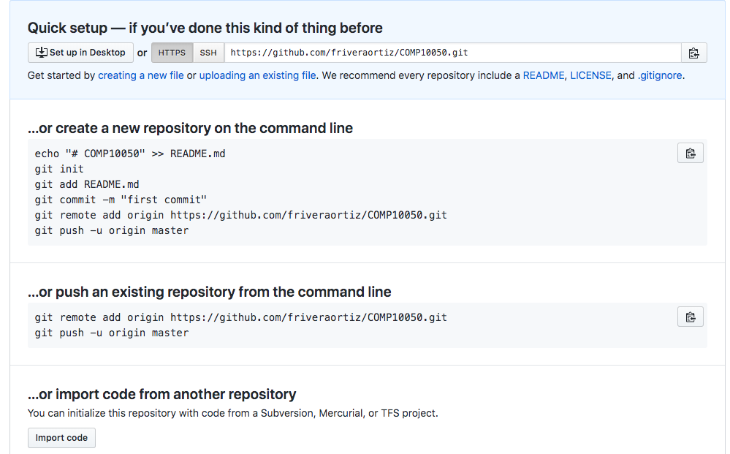
Create a New Repository
Here in the red square we can visualize the GitHub URL link of the repository, which will be our Remote Repository on the Internet.
Notes:
15

Slide 16
Step 3: Initialize a Local Repository on Your Machine

Slide 17
Assumption From Now On
If you are on a MacOS or a Linux platform from now on you will need to use the Terminal.
If you are on a Window platform you will need to use Git Bash which you must have installed when you installed Git SCM in step 1.
Git Bash is a run emulation used to run Git from the command line.
Notes:
17

Slide 18
Configure Git
Configure your identity, i.e. username and email address.
Note that your username and email address should be the same as those used to sign up on GitHub.
For example:
git config --global user.name “lpasquale”
git config --global user.email liliana.pasquale@ucd.ie
Notes:
18

Slide 19
Now you need to Initialize the Repository on Your Machine
First of all, create a directory in your computer using either Finder in MacOS or File Explorer in Windows where you want to place your repository (e.g., COMP10050)
Notes:
19

Slide 20
Initialize Your Repository
From the Terminal/Git Bash go to the directory you created. For example,
Change the filepath above with the one you created in the previous slide.
cd /Users/liliana/COMP10050
Then, initialize your repository typing the following command
git init
This command creates the .git subdirectory where all the versions of your project will be stored.
Notes:
20

Slide 21
Add Files to Your Local Repository
In the terminal create a new file named README.md containing the string “# COMP10050”. You can do so from the terminal typing the following:
echo "# COMP10050" >> README.md
Add the file to the staging area (command add) and create a new version by committing the changes to the local repository (command commit)
git add README.md
git commit –m “first commit”
Note that when you do a commit you always need to provide a message describing the changes you have applied.
Notes:
21

Slide 22
Synchronize the Local Repository with the Remote One on GitHub
In the terminal, inside the directory containing your repository, type the following:
git remote add origin https://user@github.com<remoteUrl>
git push –u origin master
Note that <remoteUrl> should be replaced with the GitHub URL of your remote repository.
For example:
git remote add origin https://lpasquale@github.com/Users/liliana/COMP10050.git
Check slide 15 to see how to view the URL of your GitHub remote repository
Notes:
22

Slide 23
Step 4: Check the Status of Your Files

Slide 24

Unmodified Files
In your terminal go to the directory of your local repository and type:
git status
It should show that your branch is up-to-date:
no tracked files (i.e. files staged for commit)
no modified files (files modified but not yet staged for commit)
no untracked files (newly added files not staged for commit)
For example:
Notes:
24

Slide 25
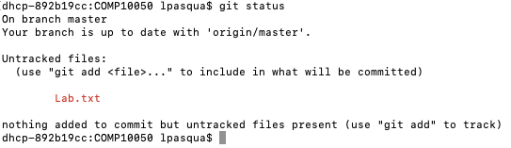
Modified Files But Not Staged
Now, add a new file to your local repository (e.g., a simple text file called Lab.txt) by typing the following
Now type the status command
echo ‘My project’ > Lab.txt
It indicates that Lab.txt has not been selected to be included in the next version of your project in the next commit).
git status
Notes:
25

Slide 26
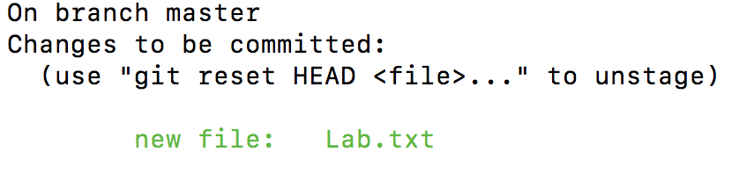
Staged Files
Go to your local repository directory and type
git add Lab.txt
Type the status command again to see that the Lab.txt is now tracked and staged to be committed
git status
You can tell that it is staged because it is under “Changes to be committed” heading.
The file will be placed in the next version of your project when you perform a commit.
Notes:
26

Slide 27
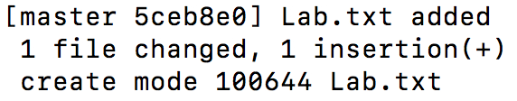
Committing Your Changes
You can type your commit message inline with the commit command by specifying it after a –m flag.
git commit –m “Lab.txt added”
Remember that only the files that are staged (i.e., you have run git add on since you edited them) will go into this commit.
Notes:
Software-intensive systems have penetrated nearly all aspects of our lives, in a huge variety of
ways. Information technology has become so powerful and so adaptable, that the opportunities for
new uses seem boundless. However, our experience of actual computer systems, once they have been developed
Computer systems are designed, and anything that is designed has an intended purpose. If a
computer system is unsatisfactory, it is because the system was designed without an adequate
understanding of its purpose, or because we are using it for a purpose different from the intended
one. Both problems can be mitigated by careful analysis of purpose throughout a system’s life.
Requirements Engineering provides a framework for understanding the purpose of a system and the
contexts in which it will be used. Or, put another way, requirements engineering bridges the gap
between an initial vague recognition that there is some problem to which we can apply computer
technology, and the task of building a system to address the problem.
It is hard now to design new software without re-thinking the human activities that wil support it.
An important observation is that the introduction of new computer technology into any human
activities inevitably changes those activities, and people inevitably find ways of adapting how they
use and exploit such technology.
27

Slide 28
Step 5: Push files to the remote repository

Slide 29
Committing Your Changes Does Not Push them to the Remote Repository
Remember that performing commits on your local repository will not propagate the new version of your project on the remote repository hosted on GitHub.
You can verify it logging in GitHub and opening your project.
You won’t be able to see file “Lab.txt”
Notes:
Software-intensive systems have penetrated nearly all aspects of our lives, in a huge variety of
ways. Information technology has become so powerful and so adaptable, that the opportunities for
new uses seem boundless. However, our experience of actual computer systems, once they have been developed
Computer systems are designed, and anything that is designed has an intended purpose. If a
computer system is unsatisfactory, it is because the system was designed without an adequate
understanding of its purpose, or because we are using it for a purpose different from the intended
one. Both problems can be mitigated by careful analysis of purpose throughout a system’s life.
Requirements Engineering provides a framework for understanding the purpose of a system and the
contexts in which it will be used. Or, put another way, requirements engineering bridges the gap
between an initial vague recognition that there is some problem to which we can apply computer
technology, and the task of building a system to address the problem.
It is hard now to design new software without re-thinking the human activities that wil support it.
An important observation is that the introduction of new computer technology into any human
activities inevitably changes those activities, and people inevitably find ways of adapting how they
use and exploit such technology.
29

Slide 30
Pushing to a remote repository
Git push is essntially the transfer of your local information to the remote repository.
If you open the terminal and go inside the directory containing your project and type the following
git push
This command will execute correctly only if you have committed your changes locally.
git push will send all the local changes to the remote repository
Notes:
The commit can be reached by following the commit history
30

Slide 31
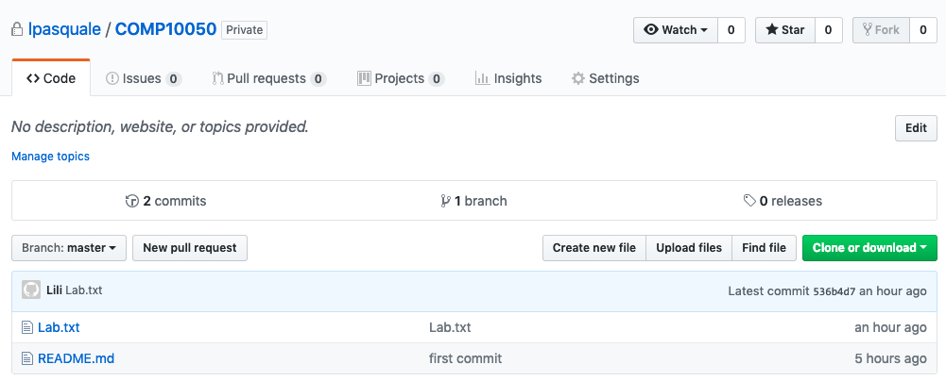
Pushing to a remote repository
You should now be able to see file Lab.txt in your remote repository on GitHub
git push
Notes:
The commit can be reached by following the commit history
31

Slide 32
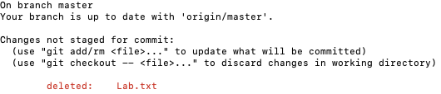
Removing Files (1/2)
To remove a file from Git, you have to remove it from your tracked files (i.e. remove it from the staging area) and then commit.
Remove file Lab.txt typing the following
rm Lab.txt
git status
If you simply remove the file using command rm, the file will show up under “Changed but not updated” (that is the unstaged area).
Notes:
Software-intensive systems have penetrated nearly all aspects of our lives, in a huge variety of
ways. Information technology has become so powerful and so adaptable, that the opportunities for
new uses seem boundless. However, our experience of actual computer systems, once they have been developed
Computer systems are designed, and anything that is designed has an intended purpose. If a
computer system is unsatisfactory, it is because the system was designed without an adequate
understanding of its purpose, or because we are using it for a purpose different from the intended
one. Both problems can be mitigated by careful analysis of purpose throughout a system’s life.
Requirements Engineering provides a framework for understanding the purpose of a system and the
contexts in which it will be used. Or, put another way, requirements engineering bridges the gap
between an initial vague recognition that there is some problem to which we can apply computer
technology, and the task of building a system to address the problem.
It is hard now to design new software without re-thinking the human activities that wil support it.
An important observation is that the introduction of new computer technology into any human
activities inevitably changes those activities, and people inevitably find ways of adapting how they
use and exploit such technology.
32

Slide 33
Removing Files (2/2)
The git rm command instead also removes the files from your working directory.
Type the following to stage the file’s removal
git rm Lab.txt
Alternatively to remove the file from git, but still keeping it in your working directory. Type:
git rm --cached Lab.txt
The file will be removed in the next commit and the changes will be propagated to the remote repository
git commit –m “Lab.txt removed”
git push
Notes:
33

Slide 34
Step 6: Collaborate with Another Teammate

Slide 35
Work in a group of 2
First, pair with a colleague who is sitting next to you.
One of the persons in the pair can add the other as a collaborator to his/her project.
Assign roles:
One person in the pair will impersonate Person A (i.e. the one that adds a collaborator)
The other person in the pair will impersonate Person B (i.e. the one that is added as a collaborator).
Notes:
35

Slide 36
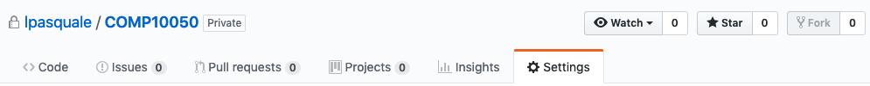
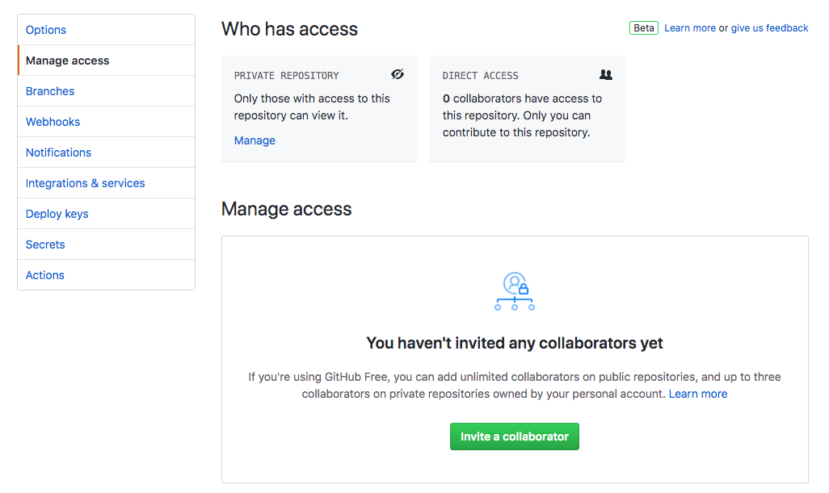
Cloning an Existing Repository (1/3)
Get a copy of an existing repository you would like to contribute to.
Person A should invite Person B to collaborate to his/her project
In the GitHub page of the project Person A should select Settings >> Manage Access and type the GitHub username of Person B in the tab below
GitHub username of Person B
Notes:
36

Slide 37
Cloning an Existing Repository (2/3)
Now Person B should do the following
Accept the invitation sent by Person A
In the terminal, create a new directory where to place the new repository
cd ..
mkdir newRepository
cd newRepository
Clone the new repository
git clone https://user@github.com <other_GitHub_url>
Note that <other_GitHub_url> should be replaced with the GitHub url of the repository of Person A. For example: git clone https://lpasquale@github.com/Users/liliana/COMP10050.git
Notes:
37

Slide 38
Cloning an Existing Repository (3/3)
Person B should now be able to see inside directory newRepository the content of the repository created by person A (e.g., file README.md). To do so Person B should type the following
ls
Notes:
38

Slide 39
Person A modifies the Repository
Person A now opens file README.md and modifies it, for example, by adding new text.
Person A subsequently commit changes in the local repository
git add README.md
git commit –m “README modified”
Person A subsequently push the changes in the remote repository
git push
Notes:
The commit can be reached by following the commit history
39

Slide 40
Person B retrieves Remote Changes
Now if Person B opens the file README.md inside folder newRepository, s/he won’t be able to view the changes that Person A has performed.
To retrieve the changes Person A has performed it will be necessary to enter directory newRepository from the terminal and type
git pull
Now if Person B opens file README.md inside folder newRepository, s/he will be able to view the changes that Person A has applied.
Notes:
The commit can be reached by following the commit history
40

Slide 41
Step 7: Deal with conflicts
In this exercise you will merge 2 branches that contain conflicting files.

Slide 42
Clone a New Repository
Now create a new folder outside your Git local repository
mkdir git-conflicts
Clone a new repository:
git clone https://github.com/hcs/bootcamp-git.git
In your new repository go to the master branch
You should visualize the following message:
Already on 'master'
Your branch is up to date with 'origin/master'.
git checkout master
Notes:
Each peer working copy is a complete repository. Repositories are synchronized exchanging patches from peer to peer.

Slide 43
Edit Conflicting Files (dog.c)
Open file dog.c in your repository
Edit the file to make it look like the one below:
Add the file to the staging area and commit:
puppy
canine
wolf
bark
bow wow
corgi
shepherd
git add dog.c
git commit –m “edited dog”
Notes:
Each peer working copy is a complete repository. Repositories are synchronized exchanging patches from peer to peer.

Slide 44
Edit Conflicting Files (dog.c)
Now change branch (origin/merge-exercise)
Edit the file dog.c to make it look like the one below:
3) Add the file to the staging area and commit.
git checkout origin/merge-exercise
puppy
canine
wolf
bark
bow wow
pikachu
charmander
squirtle
bulbasaur
charmelon
charizard
ivysaur
venasaur
wartortle
blastoise
Notes:
Each peer working copy is a complete repository. Repositories are synchronized exchanging patches from peer to peer.

Slide 45
Two conflicting files
dog.c in the master branch
dog.c in the
origin/merge-exercise branch
puppy
canine
wolf
bark
bow wow
corgi
shepherd
puppy
canine
wolf
bark
bow wow
pikachu
charmander
squirtle
bulbasaur
charmelon
charizard
ivysaur
venasaur
wartortle
blastoise
Merging the master and the origin/merge-exercise branch will cause conflicts because there are 2 different versions of file dog.c
Notes:
Each peer working copy is a complete repository. Repositories are synchronized exchanging patches from peer to peer.

Slide 46
Merge master with origin/master
1) Return to the branch repository
2) Merge the master with origin/merge-exercise repository
You should visualize the following message
git checkout master
git merge origin/merge-exercise
Auto-merging dog.c
CONFLICT (content): Merge conflict in dog.c
Automatic merge failed; fix conflicts and then commit the result.
Notes:
Each peer working copy is a complete repository. Repositories are synchronized exchanging patches from peer to peer.

Slide 47
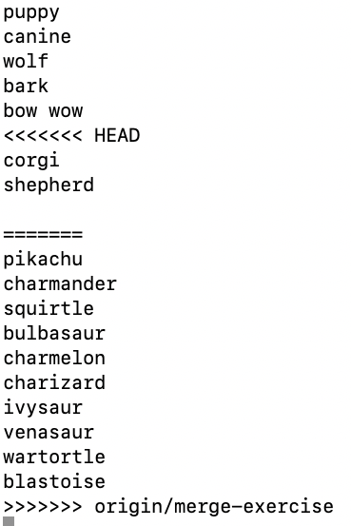
Visualize the Conflicts
1) Open file dog.c
Different parts present in the dog.c file in the master branch
Different parts present in the dog.c file in the origin/merge-exercise branch
Notes:
Each peer working copy is a complete repository. Repositories are synchronized exchanging patches from peer to peer.

Slide 48
Resolve the conflict
A possible way to resolve the conflicts would be to edit the file dog.c as follows:
puppy
canine
wolf
bark
bow wow
pikachu
charmander
squirtle
bulbasaur
charmelon
charizard
ivysaur
venasaur
wartortle
blastoise
Notes:
Each peer working copy is a complete repository. Repositories are synchronized exchanging patches from peer to peer.

Slide 49
Commit the Changes
On the command line, execute the following
git add dog.c
git commit –m “merge my dogs”
Congratulations, you resolved the Conflicts and Completed the Git Lab!
Notes:
Each peer working copy is a complete repository. Repositories are synchronized exchanging patches from peer to peer.

